Slide 1
Computer repair and maintenance
Disk cloning using mini tool wizard partition

Slide 2
Introduction
Disk cloning is a crucial process in duplicating all data on a digital storage drive, such as a hard disk or solid-state drive, using hardware or software techniques. Unlike simple file copying, disk cloning duplicates not only the data but also the filesystems, partitions, drive metadata, and slack space on the drive. Then for my side I used mini tool wizard partition as software to do the disk cloning.

Slide 3
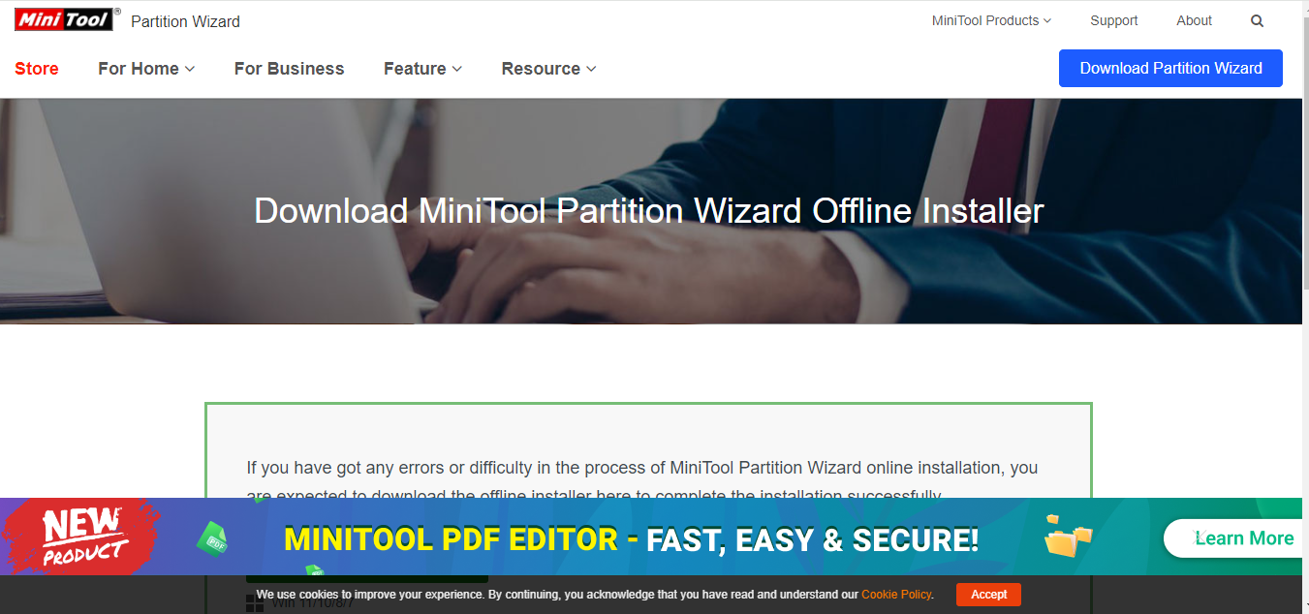
process
First of all I went to the browser then to google and I look for the mini tool wizard partition, then I went to downloaded.
As you are seeing here is the website where I went to then I downloaded the Mini tool wizard partition.

Slide 4
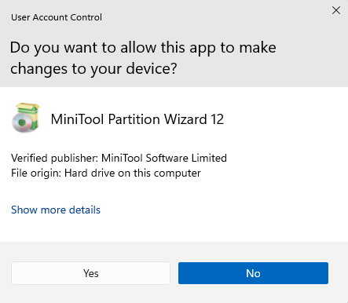
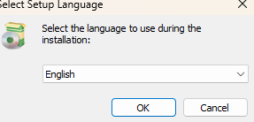
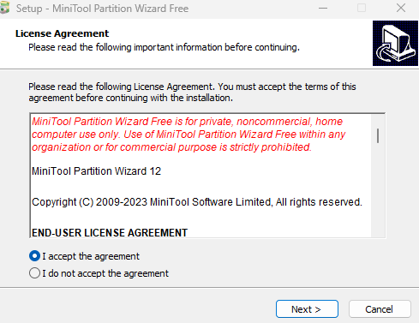
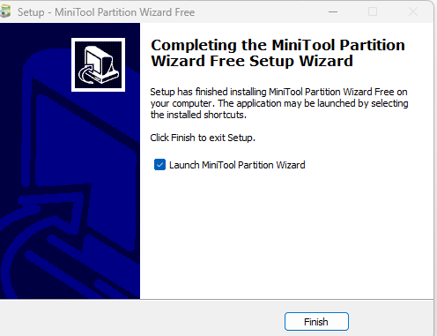
After downloaded Mini Tool wizard partition, I installed it on my computer I was following the instructions on the screen to install the software of Mini Tool Wizard partition as the pictures shows bellow :
This pictures show how I proceed through the installation and that was finished completely. Then I runed Mini Tool Wizard Partition on my pc to start the process of cloning. Here I used the external hard disk I plugged it on my pc then I started cloning.

Slide 5
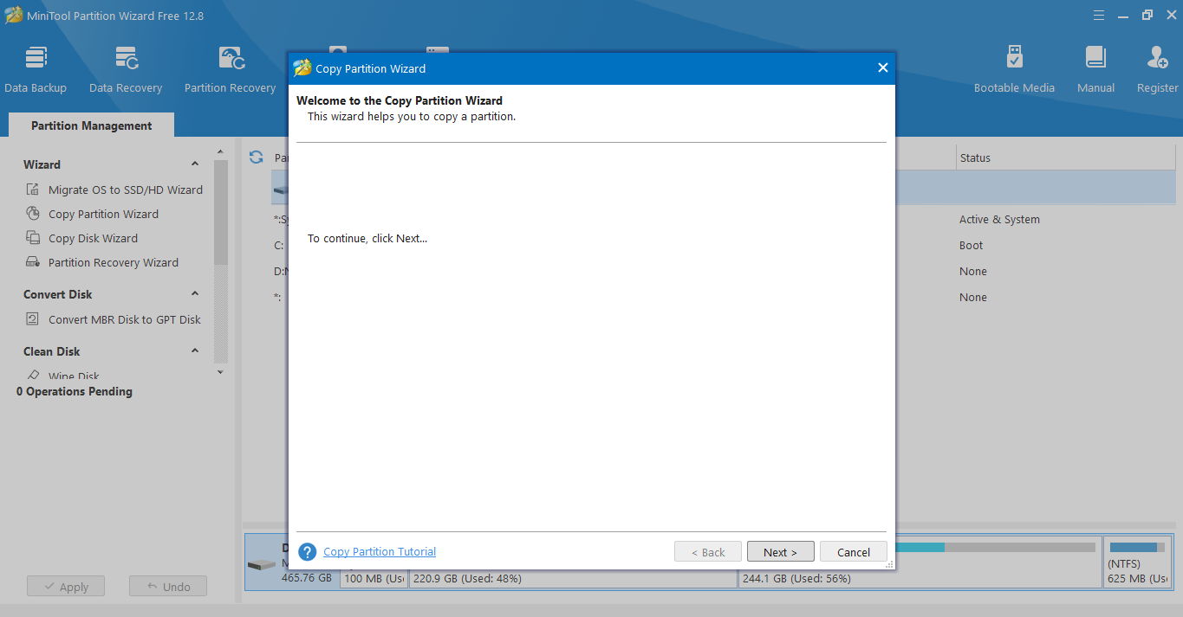
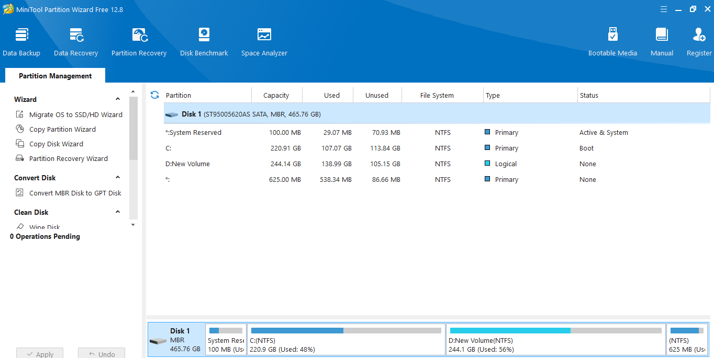
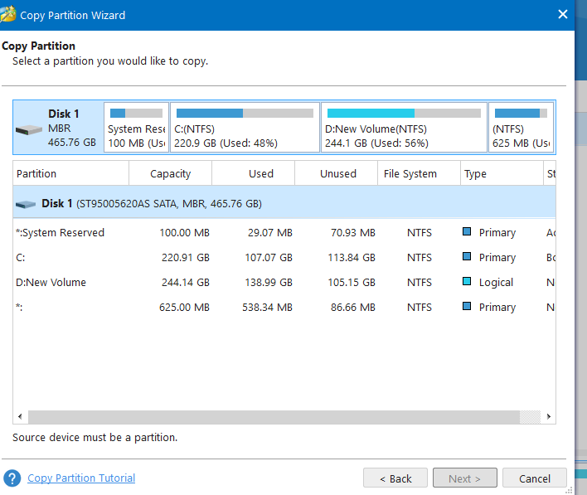
Then I opened it all the drives of my Pc was displaying there, then the boot drive system was disk 1, the target drive and is on disk 2, now I wanted to clone disk 1 to disk 5. then I position the curse on disk 1 then I clicked right button then I choose copy, then I went to disk 2 I selected it , then I clicked next. then I choose fit partition, then I clicked next again then finish. Then the process of migration start, it was taking a bit time to finish, then after time the process has finished. Then after that I went to boot into BIOS settings and set up the boot drive to disk 2.

Slide 6
Thank you

